Slide 1

How do biases creep into health data science?

Slide 2
What is bias?
Bias is a systematic error that can occur during the design, conduct, or interpretation of a study, leading to inaccurate conclusions.
Research Question
Research Team
Data Used
Data Analysis
Communication of findings
What is the issue?
Why should we care?
How can we solve it?

Slide 3
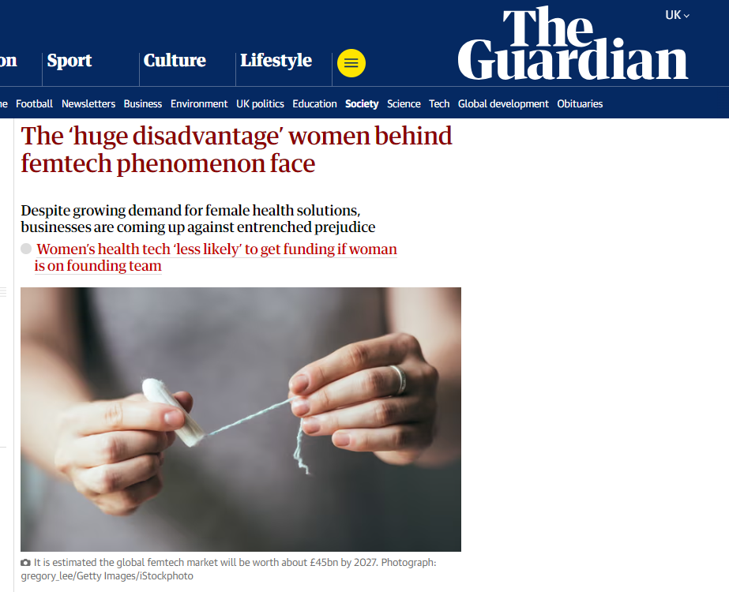
Research Question
Who sets the questions?
Questions researchers ask are influenced by cultural and socioeconomic backgrounds
Also heavily influenced by funding bodies
Research priorities are set by dominant social groups and countries
Who is invited, and who takes part in Patient and Public Involvement and Engagement? (this applies to the entire data science workflow)

Slide 4
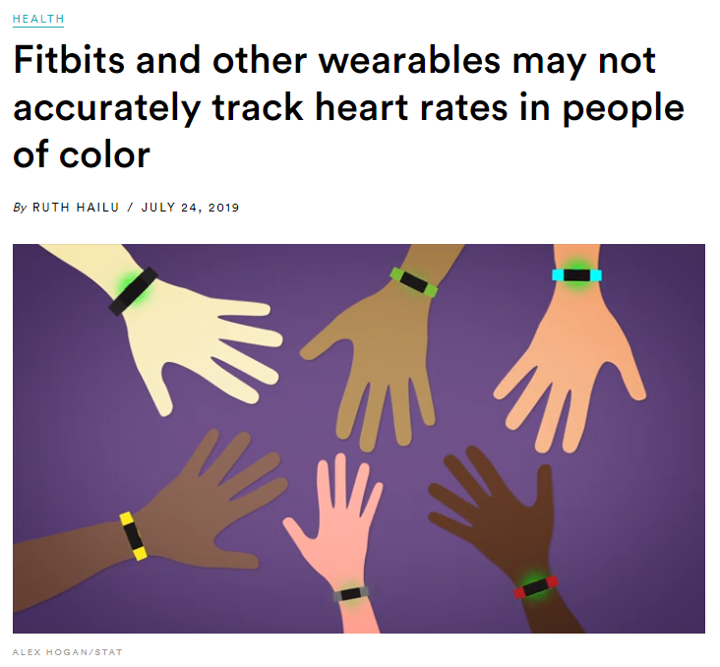
Research Team
Who is doing the research?
Lack of diversity in research teams introduces blind spots, for example:
It affects who is invited to take part in research
It affects for whom solutions are suitable
How UK science is failing Black researchers

Slide 5
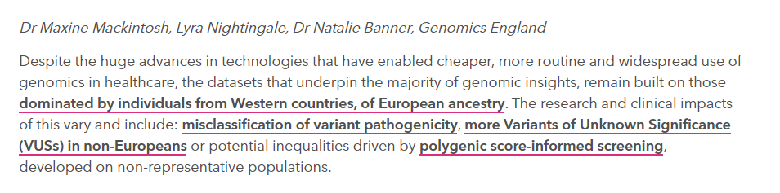
Data Used
Who participates in the research?
Whose data is used for research?
Datasets do not represent diverse populations
Not all groups are able and willing to take part in research
https://www.genomicsengland.co.uk/blog/ethical-legal-and-social-issues-in-diversifying-data

Slide 6
Data Analysis
How is the data processed?
Lack of transparency in AI algorithms
Choice of variables included in models
Choice of evaluation metrics across different groups
Challenging racism in the use of health data

Slide 7
Communication of findings
What is communicated, and to whom?
Publication of only positive results
Sharing of results only, and not analysis code and data
Publication in expensive journals
Use of scientific jargon that the public cannot understand
Data Science for Health Equity
Their library of resources

